Slide 1
Customer Conversion
Dec, 2019

Slide 2
Agenda
Business Understanding
Data Exploration
Model Building
Model Evaluation
Result & Recommendation

Slide 3

Business Understanding

Slide 4


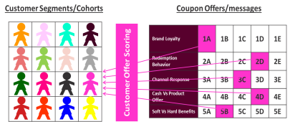
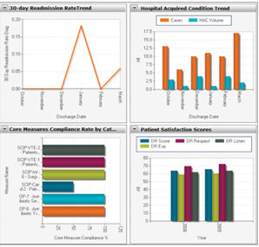

Optimizing Prospect Pricing to Drive Occupancy & Revenue
Step 1:
Economy
Step 2:
Customer Segmentation
Step 3:
Classification Modeling
Step 4:
Campaign Design
Market Analysis
Prospect
Willingness
Likelihood to
Convert
Implementation
Input: Emp.var.rate,
cons.price.rate, cons.conf.idx, euribor3m etc.
Economy , inflation affects the fixed term deposit interest Consumer confidence Inx reflect the consumer spending like monetary.
Input: What do prospects look like? Build a look-a-like model to utilize existing resident (demographics) data to segment the prospects who are more responsive to telemarketing campaigns and product
Output: Understanding the Prospects and segmentation results assist management in decision making and sales to customize (strategy, sales script) to approach prospect for better subscription
Input: Build classification
model by finding key drivers from historical data including economy, prospect profile, etc.
Output: classification score for prospects (likelihood to convert, subscribe to fixed term deposit, probability %)
Input: Based on the model, optimize & arrange better management of available resources by focusing on the potential prospects & to maximize conversion.
Output 1: Increase in subscription/conversion rate
Output 2:Improve in efficiency, save cost & time
Output 3: screen potential prospects
Output 4: target segments (based on demographics & attributes

Slide 5

Data Exploration

Slide 6
Charter
Problem Statement:
88% of volume are not qualified. Identifying right prospects which have high potential for subscription conversion will be very helpful in increasing salesforce productivity
Business Case:
Prioritizing prospects based on high probability of conversion helps in higher success rate , better workforce productivity, easier/ efficient execution of campaign and to focus quality time with better prospects.
Out of Scope :
Prospect segmentation, demographics data, design of campaign, competitor market share
In Scope :
Data from previous bank campaign to classifying the prospects
Goals :
Increase subscription conversion rate or success rate , save money and time

Slide 7
Data Exploration
Data contained 20 different features on more than 41,000 customer.
Good number of categorical and numerical. target variable was binary (“yes” or “no”).
All variables were summarized, visualizations were created to understand the conversion rate , statistical significance using chi-square test to check the independence, cross tabulation

Slide 8
Data Preparation
Many features had missing values. Education, Job, housing, loan are significant variable, so we need to impute the missing values
Categorical features, imputation using the decision tree because prior analysis using cross tabulation shows that 'job' and 'education'; 'age' and 'job'; 'home ownership' and 'loan status are highly dependent.'
Among other features, column (“nr of employees'', "default”) has high missing values so used the values as is
‘pdays has high # of missing values so to handle this it was converted from a numerical feature to a categorical feature using buckets: <1-week, 1-2 week, etc.
Created dummy variable using one-hot encoding
and analyzed the correlation
Dropped variable with high multicollinearity, correlations between the independent variables and the target variable outcome.
Missing values are imputed using the independent variables to infer the missing values
Note : After and before imputation ensured the correlations make sense

Slide 9
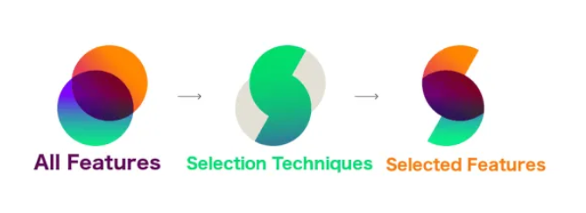
Feature selection :
Correlation coefficient , step wise logit regression
& caret package is used to remove redundant features
Recommendation
High-cardinality categorial attributes - Supervised ratio, weight of evidence etc. methods can be used to deal with cardinality
For day and month – seasonality index can be created
Collect more attributes like, income, gender, demographics like zip code data of customers
Collect market share, competitor data

Slide 10
Model Building

Slide 11

Imbalanced Data
There is data imbalance between two classes The number of yes(1) is very low in comparison to no(0)
To deal with data imbalance we use SMOTE - Synthetic Minority Over-sampling Technique.
SMOTE creates synthetic (not duplicate) samples of the minority class. Hence making the minority class equal to the majority class.
SMOTE does this by selecting similar records and altering that record one column at a time by a random amount within the difference to the neighboring records.

Slide 12
Model used
Modelling techniques used :
Logistic Regression
Random Forest
Gradient Boosting
Duration variable has a very strong correlation with the
Target variables. Duration cannot be known until after the call has ended, after the call (mostly) the outcome from the customer is already known.
Before phone call
With duration
No call Model
Call Model
better workforce productivity,
easier/ efficient execution of campaign
Customized marketing scripts
Save money & cost
Higher success rate
focus quality time with better prospects.

Slide 13
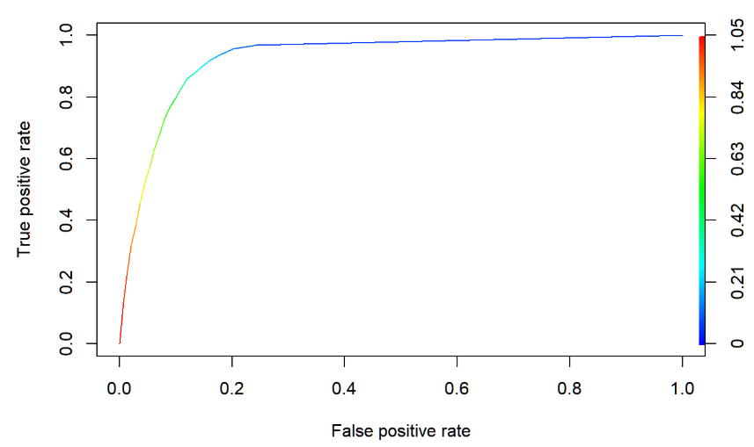
Best Model
Best Model: Random Forest with high AUC, F1 score, recall value
Used ROC curve for the trade off value
Receiver Operating Characteristic(ROC) summarizes the model’s performance by evaluating the trade offs between true positive rate (sensitivity) and false positive rate(1- specificity).
Higher the area under curve, better the prediction power of the model

Slide 14
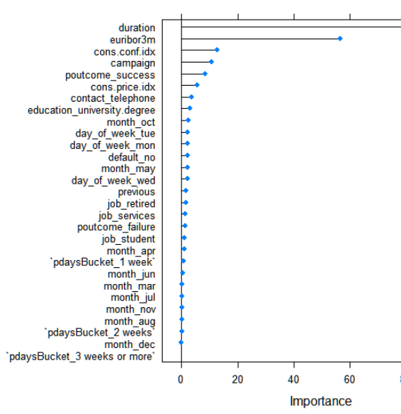
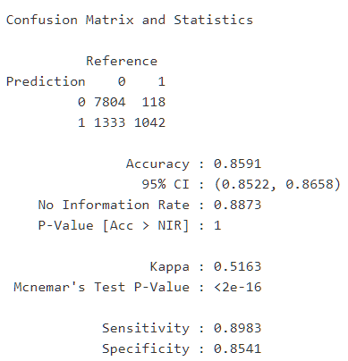
With call duration model able to captured 89% positive response
Feature Importance
The model significantly reduced the workload & costs by marketing over a smaller group with higher propensity to subscribe instead of massive population

Slide 15
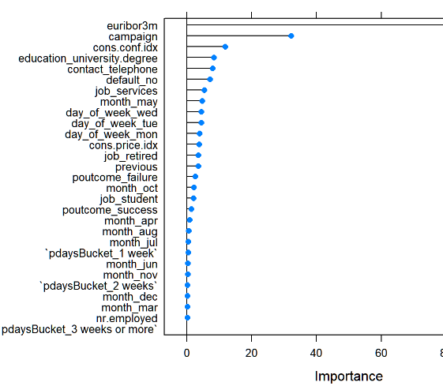
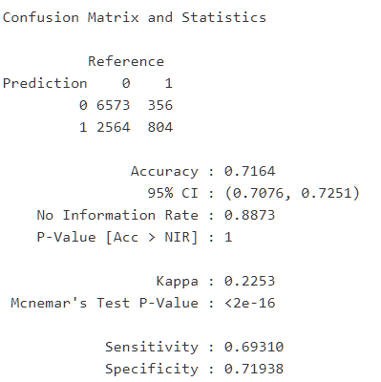
Without call duration model able to captured 69% positive response
Feature Importance
The model significantly reduced the workload & costs by marketing over a smaller group with higher propensity to subscribe instead of massive population

Slide 16

Campaign Recommendation
Run the campaigns when the macroeconomic environment is stable
Marketing scripts should be modified as per the target customer in order to engage customers
Prioritize those customers to who were part of the previous marketing campaigns, retired professionals, and customer who are in services
Forecast & recognize the market conditions and pro-actively capture customers before competitors
Preferably use Telephone as mode of communication

Slide 17
Appendix

